Slide 1

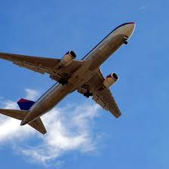
Flight Ticket: Price Prediction

Slide 2
SUBMITTED BY Steffin Varghese

Slide 3
INTRODUCTION
Anyone who has booked a flight ticket knows how unexpectedly the prices vary. The cheapest available ticket on a given flight gets more and less expensive over time. This usually happens as an attempt to maximize revenue based on –
1. Time of purchase patterns (making sure last-minute purchases are expensive).
2. Keeping the flight as full as they want it (raising prices on a flight which is filling up in order to reduce sales and hold back inventory for those expensive last-minute expensive purchases).
As the flight ticket price is fluctuating, we have to work on a project where you collect data of flight fares with other features and work to make a model to predict fares of flights.

Slide 4
Understanding the Problem
Air travel has evolved into a popular, necessary, and quick mode of transportation thanks to the ever-increasing interconnectedness of air routes around the globe. For airlines, predicting prices is a crucial yet difficult issue because prices are always fluctuating and are known to depend on a wide range of factors.
Given that more and more individuals are choosing to travel faster, flying has become an essential aspect of modern life. The cost of airline tickets fluctuates depending on a number of variables, including the scheduling, destination, and duration of the flight. various times, including holidays or the festive season. Therefore, many people will undoubtedly benefit from saving money and time by having a basic understanding of the flight costs before to planning the trip.
With extensive research in the domain, it has been found that an estimation of flight costs at a given time can be obtained within seconds utilising machine learning and artificial intelligence approaches.

Slide 5
Steps in Exploratory Data Analysis
Loading the dataset
Characteristics of Dataset
Exploring Categorical Variables
Checking for Missing Values
Encoding the Categorical Variables
Statistical Summary
Data Visualization
Correlation
Distribution of Data
Checking the Skewness and Outliers
Data Cleaning
PCA Techniques
Pre-processing

Slide 6
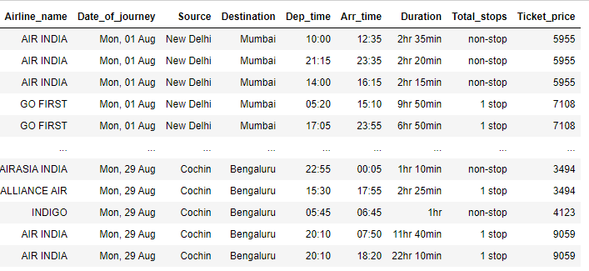
Data Sources and their formats
We had to scrape minimum 1500 records of flight journeys including the ticket price from websites. There was no limit to the number of columns. Generally, these columns include, are airline name, date of journey, source, destination, route, departure time, arrival time, duration, total stops, and the target variable price.
We have scraped flight ticket records from the website www.ixigo.com. The data was collected for the popular cities: -
New Delhi Mumbai Chennai
Bangalore Kochi
We have collected 8700 records for flight journeys including the following information: -
Airline Name Date of Journey Source Destination
Duration Departure Time Arrival Time
Total Stops Ticket Price
The data was collected for the month of August 2022 and the data collected was on 20 July 2022.
Dataset
We have 8700 rows and 9 columns in the dataset.
We have string and integer type of data in the dataset.
We have 8700 non null values in all the columns of the dataset.

Slide 7
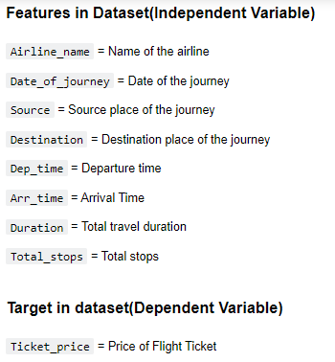
Data Variable Description

Slide 8
Data Preprocessing
Exploring Categorical Variables
We have extracted the day of month and weekday from the column ‘Date_of_journey’ and added them as new column.
We have extracted the hour and minute from the columns ‘Dep_time’ and ‘Arr_time’ and added them to dataset as new columns.
We also converted the values in the column ‘Duration’ to minutes.

Slide 9
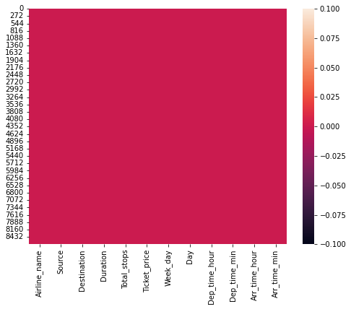
Checking for Missing Values
Heatmap for checking missing values in the dataset.
We don't have any missing values in the dataset.

Slide 10
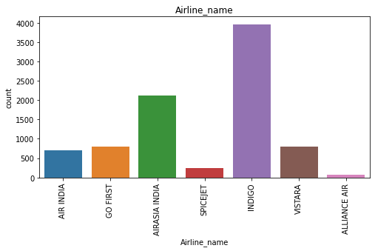
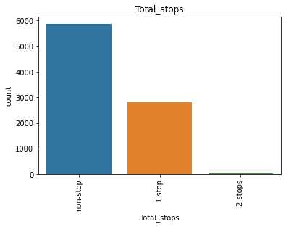
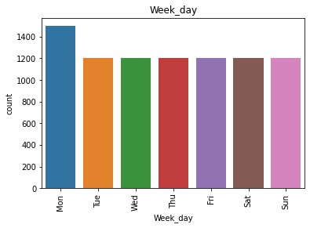
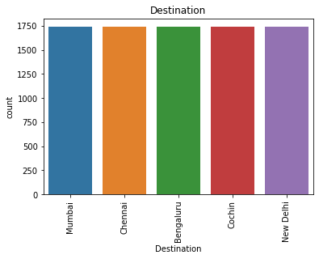
Data Visualization
Univariate Analysis
Categorical Variables – Using Countplot
Observations:
Most of the flights in the dataset are of Indigo Airlines. Second highest flights in the dataset are of AirAsia India Airlines.
Most of the flights are taking off from New Delhi airport while the least number of flights are taking off from the Mumbai Airport.
We have 5 destination airports in the dataset. We don't have any difference in the number of data for the flights which are landing off in these cities.
Most of the flights in the dataset are having no stop in between the journey.
Most of the flights are having the journey on Monday compared to other weekdays.

Slide 11
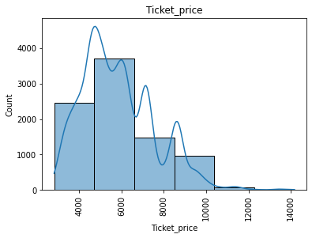
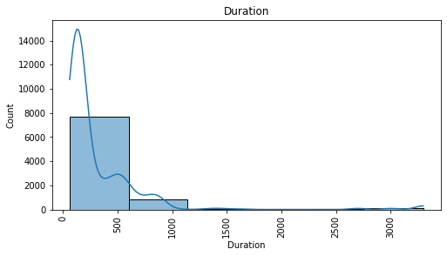
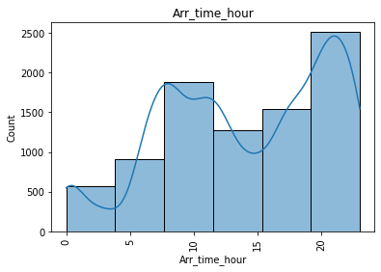
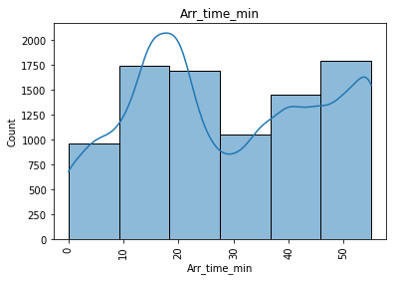
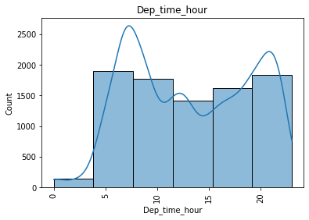
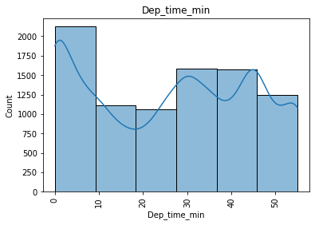
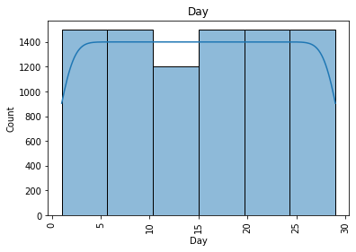
Numerical Variables – Using histogramplot
Observations:
Most of the flights are having a duration time between 60 to 600 minutes.
Most of the flights tickets are having a flight fare between the range Rs 4700 to Rs. 6600.
The number of flights which are having higher number of journeys are during the beginning and end of a month. The number of flights between the 10th and 15th day of month is comparatively less.
The number of flights which are taking off between 12.00 AM to 4.00 AM is comparatively less compared to other hours during the day. Rest of the hours in a day are having similar number of flight departure time.
Most of the flights are taking off in first 10 minutes of any hour for a day.
Most number of flights are landing off between the 07.00 PM. to 11.59 PM for a day.
As per the dataset, the number of flights which are landing off between 10 to 28 minutes and 45 to 59 minutes of an hour is more compared to other time intervals of any hour in a day.

Slide 12
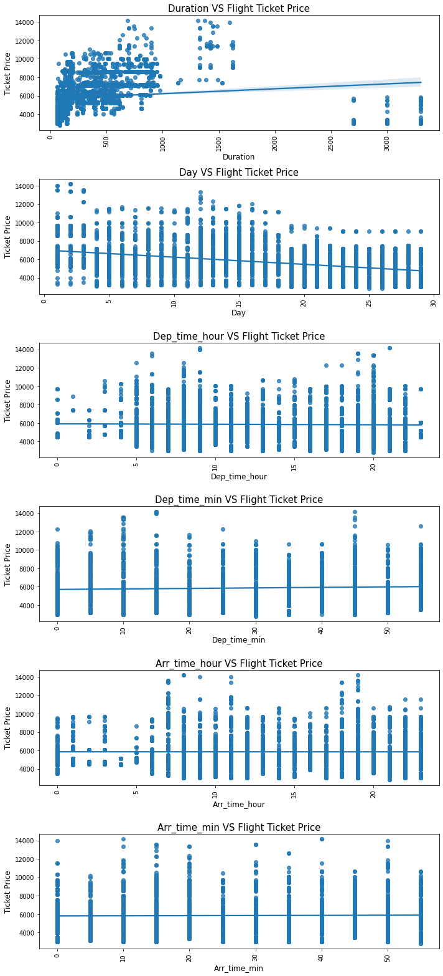
Bivariate and Multivariate Analysis
Observations:
The flight journey duration is having a slight impact to the increase in flight ticket price. But the data is not uniform between each interval of duration.
The day of flight journey in a month is having a slight impact to the decrease in flight ticket price. The flight ticket price is higher during the start of month compared to the flight ticket price end of month. So, it is better to travel in flights during the end of month than the beginning of the month.
The flight ticket price is higher between 05.00 AM to 10.00 A.M and between 05.00 PM to 09.00 PM of the day. The flight price is low for the rest of the hours in a day. So, it is better to choose a flight which is not in the busy hours.
The flight ticket price is higher for flights which are taking off at 10,15 and 45 minutes of an hour of any day
The flight ticket price is higher if the flight is arriving at the destination between 06.00 AM to 11.00 AM and 06.00 PM to 07.00 PM of a day.
The arriving time minute of a flight is not having much impact on the price of flight ticket as the price is almost uniform in different interval of minutes of hours in a day.

Slide 13
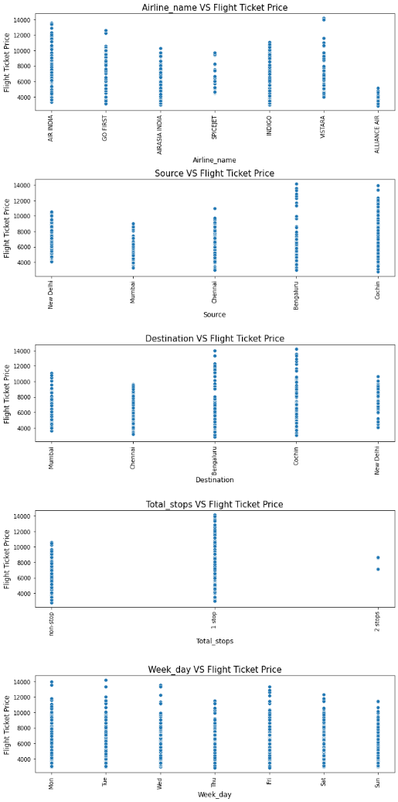
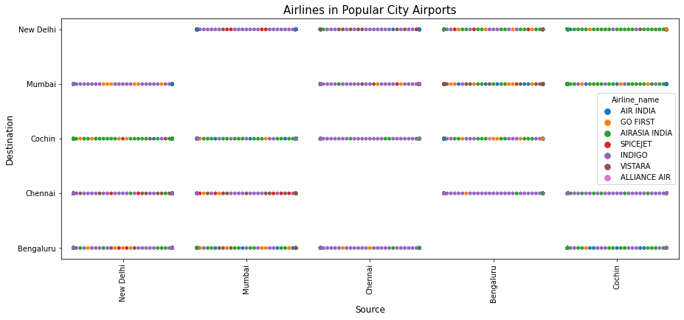
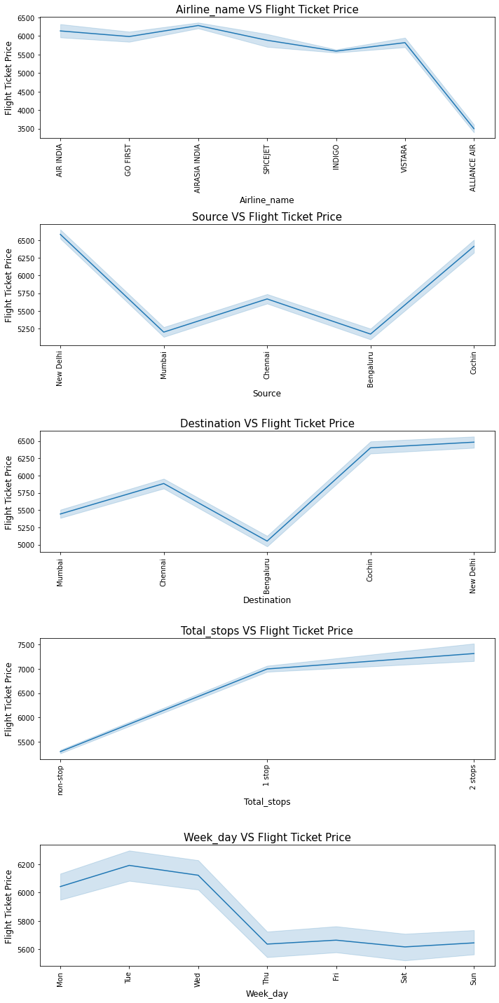
Observations:
The flight ticket price is higher for the Vistara and Air India airlines while SpiceJet and Alliance Air flights are having comparatively less flight fare.
Flights fare is higher for flight which are taking off and landing in Bengaluru and Cochin airports compared to other airports.
The flight ticket price is higher for flights which are having one stop in between journey.
The flight ticket price is high during the start of a week and decreasing to weekend.

Slide 14
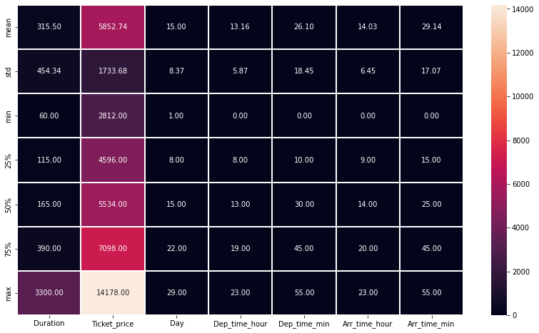
Statistical Summary
Heatmap of Describe of Data
Observations:
All the columns except the columns ['Day', 'Dep_time_min'] are having higher mean value than the median. That means the distribution of values in these columns are not normal and skewness is present in the data distribution.
The max value of the columns ['Duration', 'Ticket_Price'] are having huge difference between the 75%. Possible outliers are present in the data of these columns.

Slide 15
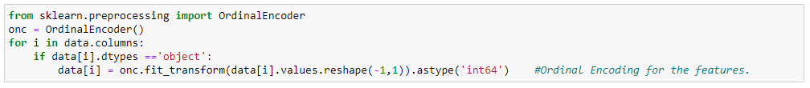
Encoding the Categorical Columns
Encoding the Categorical Variable data
We have encoded the categorical columns of the dataset.

Slide 16
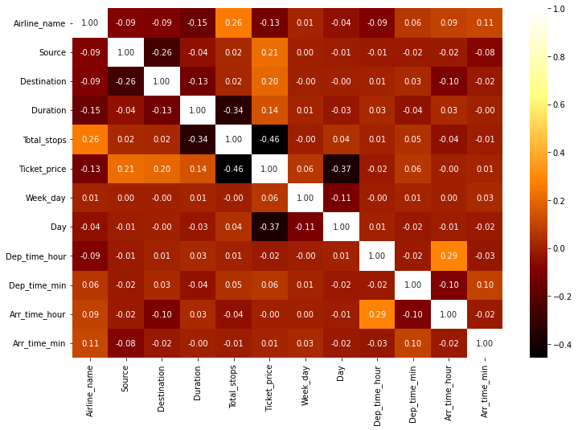
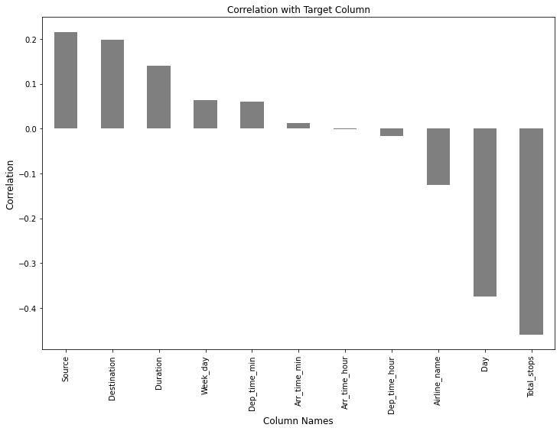
Correlation
Heatmap of Correlation between variables
Correlation with Target Variable

Slide 17
Correlation with Target Variable
Source 0.214695
Destination 0.197541
Duration 0.139878
Week_day 0.063736
Dep_time_min 0.060005
Arr_time_min 0.012615
Arr_time_hour -0.001085
Dep_time_hour -0.017314
Airline_name -0.125710
Day -0.374815
Total_stops -0.458598
Observations:
The columns ['Source', 'Destination', 'Duration', 'Week_day', 'Dep_time_min', 'Arr_time_min'] are positively correlated to the target variable 'Ticket_price', while the rest of the columns in the dataset are having negative correlation to the target variable 'Ticket_price'.
The column 'Source' is having highest positive correlation to the target variable whereas the column 'Total_stops' is having highest negative correlation to the target variable 'Ticket_price'.
The column 'Arr_time_min' is having the least positive correlation to the target variable 'Ticket_price', while the column 'Arr_time_hour' is having the least negative correlation to the target variable 'Ticket_price'.

Slide 18
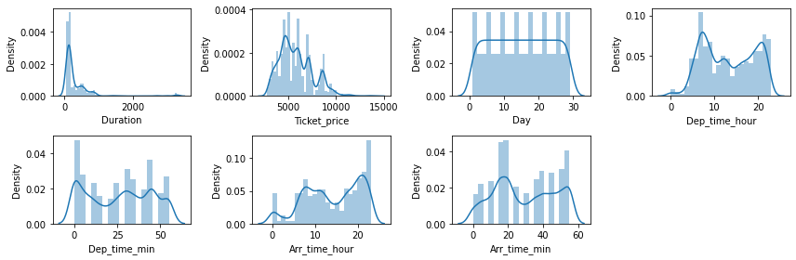
Distribution of Data in Numerical Columns (Skewness)
Data Distribution
Observations:
The columns except the column 'Day' are not having normal distributions.
Skewness is present in the data of all numerical columns except the column 'Day'.

Slide 19
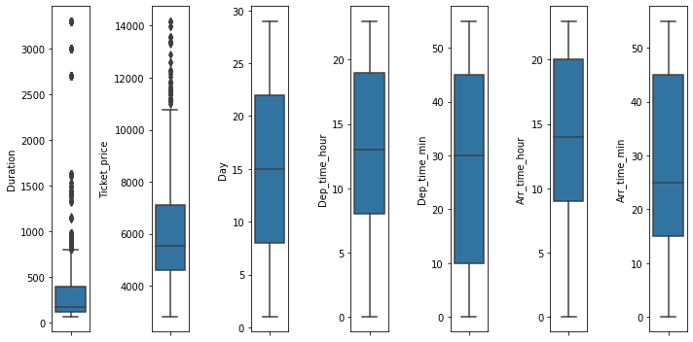
Presence of Outliers in Numerical Variables
Presence of outliers in the dataset using boxplot
The columns ['Duration', 'Ticket_price'] are having outliers present in the data.
The column 'Ticket_price' is our target variable, so we will not consider the outliers in this column as it is required for building our model.

Slide 20
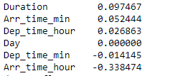
Data Cleansing
Removing the skewness and outliers
Only the column ‘Duration’ had skewness which was beyond the standard limit.
After reducing the skewness using power transform, the data skewness brought down to: -
After reducing the skewness, we are not having any outlier data in the dataset.
Skewness after power transform

Slide 21
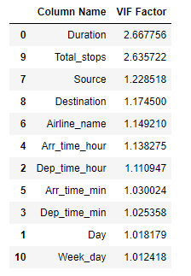
Checked and Removed Multicollinearity from the Datasets
We can see that the variance of inflation is least for the columns. That means there is not much multicollinearity present between the variables in the dataset.
Variance of Inflation of Variables

Slide 22
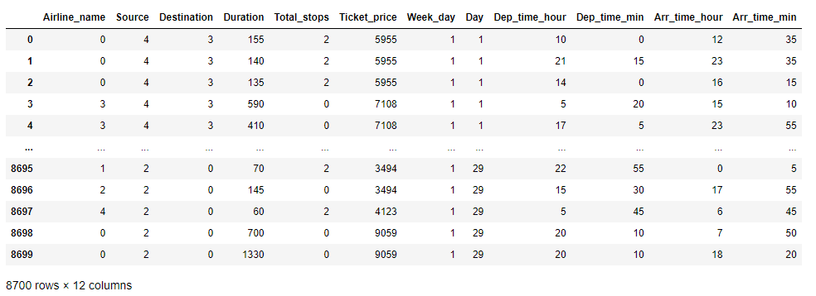
Final Dataset
Final Dataset after data cleansing and pre-processing

Slide 23
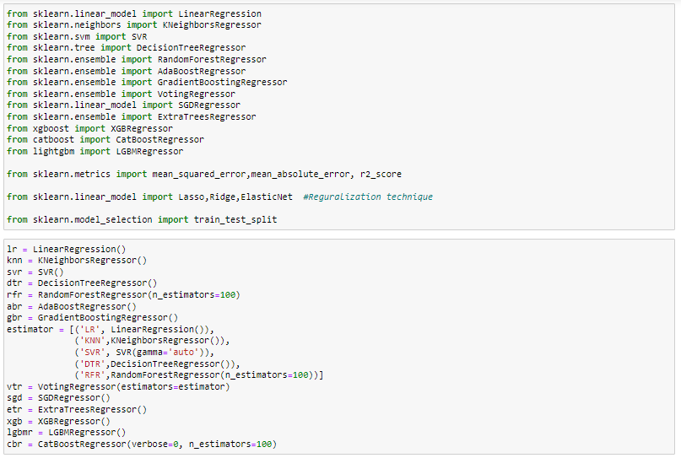
Model/s Development and Evaluation
We created three functions for testing the model and for cross validations:
best_ran : Finding the best random state for the selected model
mod_test : Ttraining the model with the train data using the best random state.
cross_val : Finding the best cross validation mean score for each model.

Slide 24
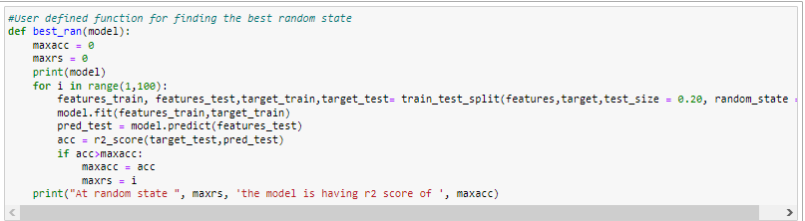
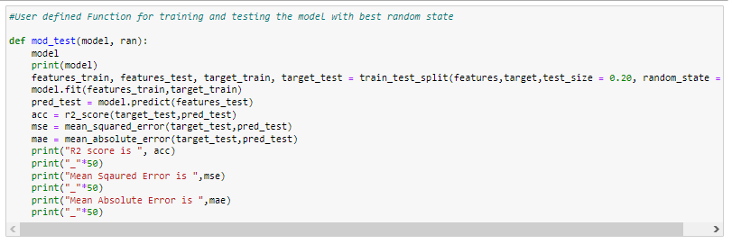
Testing of Identified Approaches (Algorithms) and evaluation of selected models
Code Snippet for function to find best random state
Code Snippet for function to test the model

Slide 25
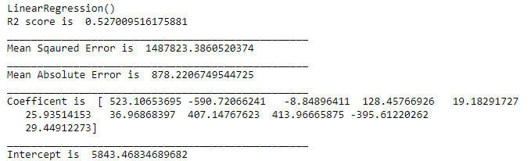
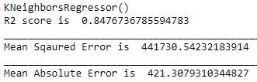
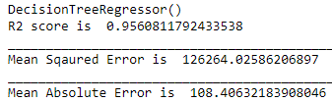
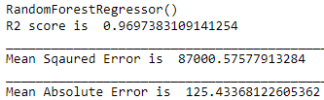
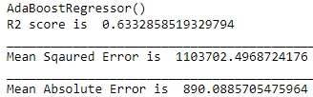
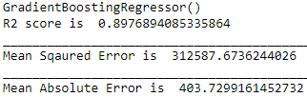
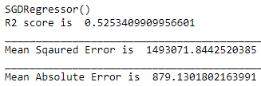
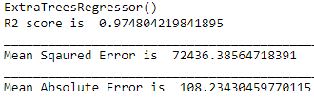
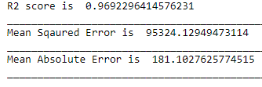
Linear Regression
KNeighbors Regressor
DecisionTree Regressor
Testing the model performance
Testing the model performance
Testing the model performance
RandomForest Regressor
AdaBoost Regressor
GradientBoosting Regressor
Testing the model performance
Testing the model performance
Testing the model performance
SGD Regressor
XGB Regressor
ExtraTrees Regressor
Testing the model performance
Testing the model performance
Testing the model performance

Slide 26
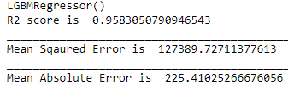

LGBM Regressor
CatBoost Regressor
Testing the model performance
Testing the model performance
After testing the data with the regression algorithms, most of the models are performing well and providing the best R2 Score.

Slide 27
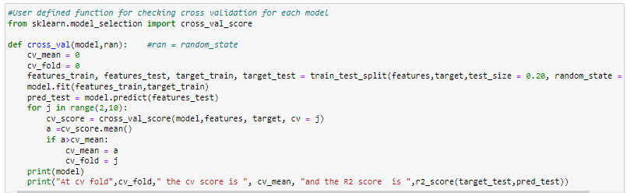
Cross Validation
Code Snippet for function to find the cross validation mean score
Linear Regression
At cv fold 5 the cv score is 0.07036419325235899 and the R2 score is 0.527009516175881
KNeighbors Regressor
At cv fold 6 the cv score is 0.3116648860583661 and the R2 score is 0.8476736785594783
DecisionTree Regressor
At cv fold 5 the cv score is 0.3441344925813712 and the R2 score is 0.9594829955818878

Slide 28
RandomForest Regressor
At cv fold 5 the cv score is 0.29547815277943074 and the R2 score is 0.9697482782184201
AdaBoost Regressor
At cv fold 2 the cv score is 0.22613569274209 and the R2 score is 0.6190540964323343
GradientBoosting Regressor
At cv fold 7 the cv score is 0.4492890940990274 and the R2 score is 0.8976894085335864
SGD Regressor
At cv fold 5 the cv score is 0.06829978503296896 and the R2 score is 0.5275310053010887
ExtraTrees Regressor
At cv fold 9 the cv score is 0.49297123686094024 and the R2 score is 0.9747227889478558
XGB Regressor
At cv fold 7 the cv score is 0.4802321705474825 and the R2 score is 0.9692296414576231
LGBM Regressor
At cv fold 5 the cv score is 0.3826905302044449 and the R2 score is 0.9583050790946543
CatBoost Regressor
At cv fold 9 the cv score is 0.46628797931931476 and the R2 score is 0.9636998893569437

Slide 29
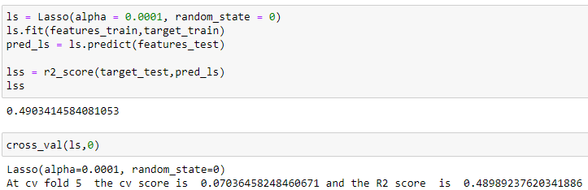
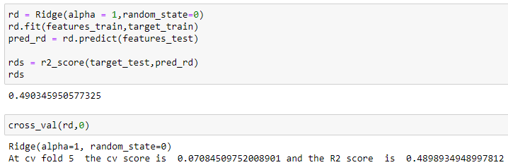
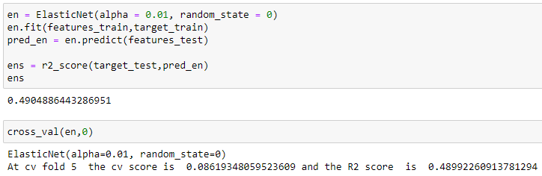
Regularization
Lasso(L1)
Ridge(L2)
Lasso Regularization Performance
Ridge Regularization Performance
ElasticNet
The regularization techniques didn't provide any better results.
ElasticNet Regularization Performance

Slide 30
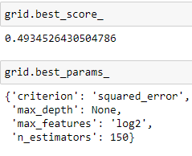
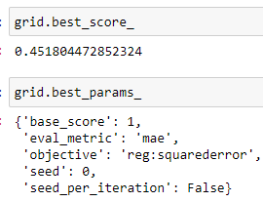
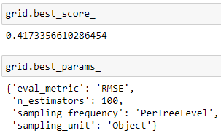
Hyperparameter Tuning
ExtraTree Regressor
XGBoost Regressor
CatBoost Regressor
Best Score and Parameters
Best Score and Parameters
Best Score and Parameters
After all the tests, cross validations, regularizations and hyperparameter tuning the XGBoost model is performing well. So, we can consider this model as the best performing model.

Slide 31
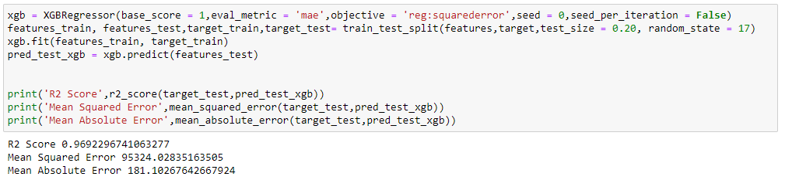

Finalized Model Performance with Tuned Parameters
Final Model Performance
Saving the best model
We have saved the machine learning model for future predictions. We have serialized and saved the binary file as “flight_ticket_price_prediction_model.pkl” using the pickle library.

Slide 32
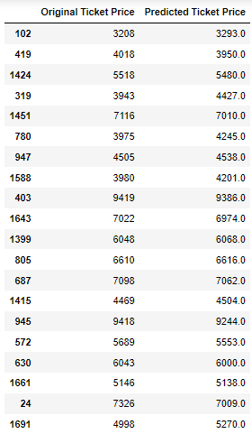

CONCLUSION
Now we have trained our model and it is ready to test with the actual data to cross verify the performance.
Model performance with predictions vs actual price
Our model is performing well with predictions and provided almost accurate results. The XGBoost model(xgb) is providing a final R2 Score of 96.92%.
Model Predictions and Actual Price

Slide 33
Key Findings and Conclusions of the Study
With the help of data science and machine learning, we were able to create a machine learning model using XGBoost algorithm, which can predict the price of flight ticket price.
Now this model can be used to predict the price of flight ticket price in India with the following variable information about the flight journey and flight. (Important Variables)
Duration Total_stops Source Destination Airline_name Arr_time_hour
Dep_time_hour Arr_time_min Dep_time_min Day Week_day
Impact of Variables on Target Variable (Correlation)
The columns ['Source', 'Destination', 'Duration', 'Week_day', 'Dep_time_min', 'Arr_time_min'] are positively correlated to the target variable 'Ticket_price', while the rest of the columns in the dataset are having negative correlation to the target variable 'Ticket_price'.
The column 'Source' is having highest positive correlation to the target variable whereas the column 'Total_stops' is having highest negative correlation to the target variable 'Ticket_price'.
The column 'Arr_time_min' is having the least positive correlation to the target variable 'Ticket_price', while the column 'Arr_time_hour' is having the least negative correlation to the target variable 'Ticket_price'.

Slide 34
Limitations of this work and Scope for Future Work
Limitations
We tried to include as many features as possible which were available at the time of data collection. But still this is not enough to build a powerful model as the aviation market is always fluctuating and are affected by various factors.
The data is missing other factors which can make an impact on the flight fare such as fuel price, class, weather, festival or seasons at source and destinations, time, and date of booking the flight etc.
The source data was limited to one website and the data was only collected for one month. For building a powerful model, we have to include flight fare records for different timeframes and also different time which we are checking the flight fares.
We had only included the major airports in India. There are other airports in India, and we also have to include international journeys which will increase the volume of the dataset.
Scope
In future, to build a powerful predictive model for flight fare prediction, we can include a large dataset including much more important features that are making impact on the flight ticket price
We should also consider international flight journey records and include more airlines from various sources and websites. Our model is scalable and can be improved by including more data and adding more features.
As the data science is advancing, in future, we will be able to use much more powerful algorithms and approaches such as deep learning and artificial intelligence.

Slide 35
Thank You

